Slide 1
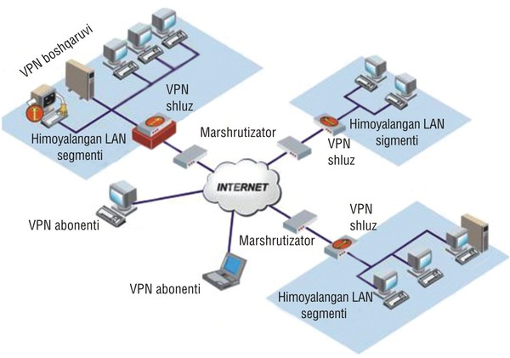
TARMOQ ADMINISTRATORLIGI 18-DARS

Slide 2
User yaratish
Useradd –m user1 user yaratish
Userdel –r usernomi userni o’chirish
Ls –l /home
Cat /etc/passwd user bor yaratilganligni tekshirish
Cat /etc/shadow userga parol bor yo’qligini tekshirish
Passwd user1 userga parol qo’yish

Slide 3
User yaratish
Cd /etc/skel/ user yaratilganda userni ichiga avtomat ravishda papkalar yaratish uchun oldindan papka yaratish yuli
Mkdir desktop papka yaratish
Mkdir video papka yaratish
Touch file.txt fayl yaratish
Ls –l
Useradd –m user2 user yaratish
Ls –l /home/

Slide 4
User yaratish 2-usuli
Adduser usernomi user yaratish
Deluser usernomi userni o’cherish
Addgroup guruhnomi guruh qo’shish
Delgroup guruhnomi guruhnomi

Slide 5
Group yaratish
Groupadd guruhnomi guruh yaratish
Cat /etc/group guruhni tekshirish
Groupdel guruhnomi guruhni o’chirish
Id usernomi userni id si va guruhini tekshirish
Usermod –aG guruhnomi usernomi userni guruhga qo’shish
Id usernomi Id si va guruhini tekshirish
Deluser guruhnomi usernomi userni guruhdan chiqarish
Id usernomi Id si va guruhini tekshirish
rm –fr /home/usernomi userni o’cherish
adduser user nomi sudo // sudo guruhga qo’shish yaniy rootga

Slide 6
Papka fayllarga huquq berish
r- read-4 o’qishga huquq
w- write-2 yozishga huquq
x- execute-1 bajarishga huquq
(4+2+1=7) ☺
Misol: chmod 777 (fayli yoki papkanomi)
chmod 777 * (turgan joydagi barcha fayllar yoki papkaga ga barcha huquqni beradi)
owner – group – others
rwx- rwx- rwx >>777ga teng yani hama huquq bor(ochilgan)
rwx- r-x r-x >>755ga teng

Slide 7
Topshiriq
1.egasi uchun hamma narsaga ruxsat berish, qolganlari faqat o'qish;
2. egasi uchun hamma narsaga ruxsat berish, qolganlari faqat o'qish, ishga tushirish uchun
3. egasi uchun hamma narsaga ruxsat berish, guruh uchun o'qish va yozish, faqat qolganlari uchun o'qish
4. Hamaga barcha huquqlar berilsin
????

